Slide 1
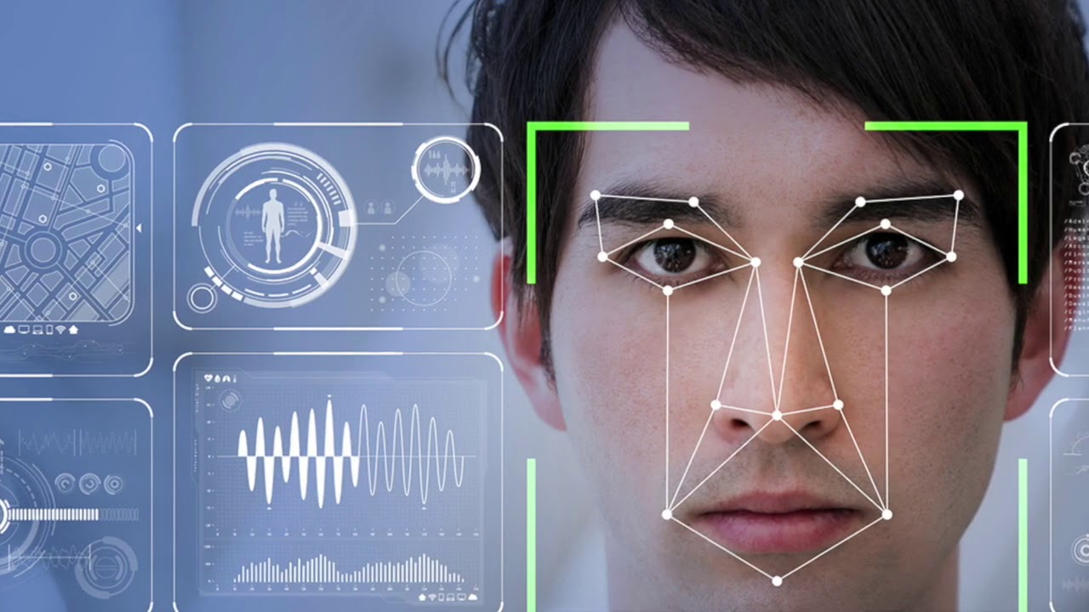

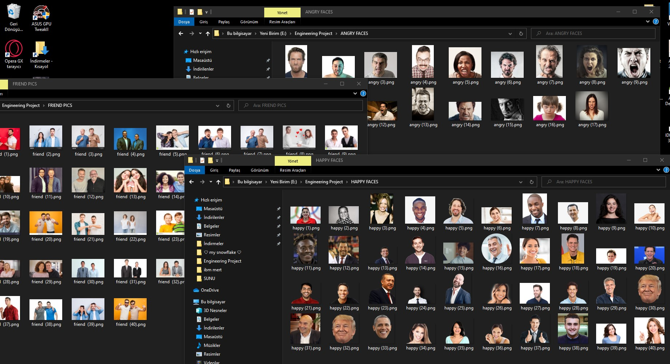
Engineering Project- I Facial Emotion Detector
MERT ALTUNTAŞ

Slide 2
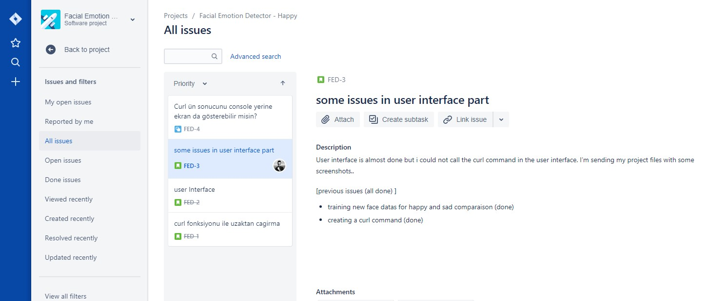

About Project
This Project aims detecting facial emotions of people and in additional, recognizing other objects except people.
In general this Project based on artifical intelligence.
My Partners : Panashe Korongah, Ataberk Kaçan

Slide 3



Changes on the list of Requirements
> Changes on Development Tools;
> Adding More Categories;

Slide 4
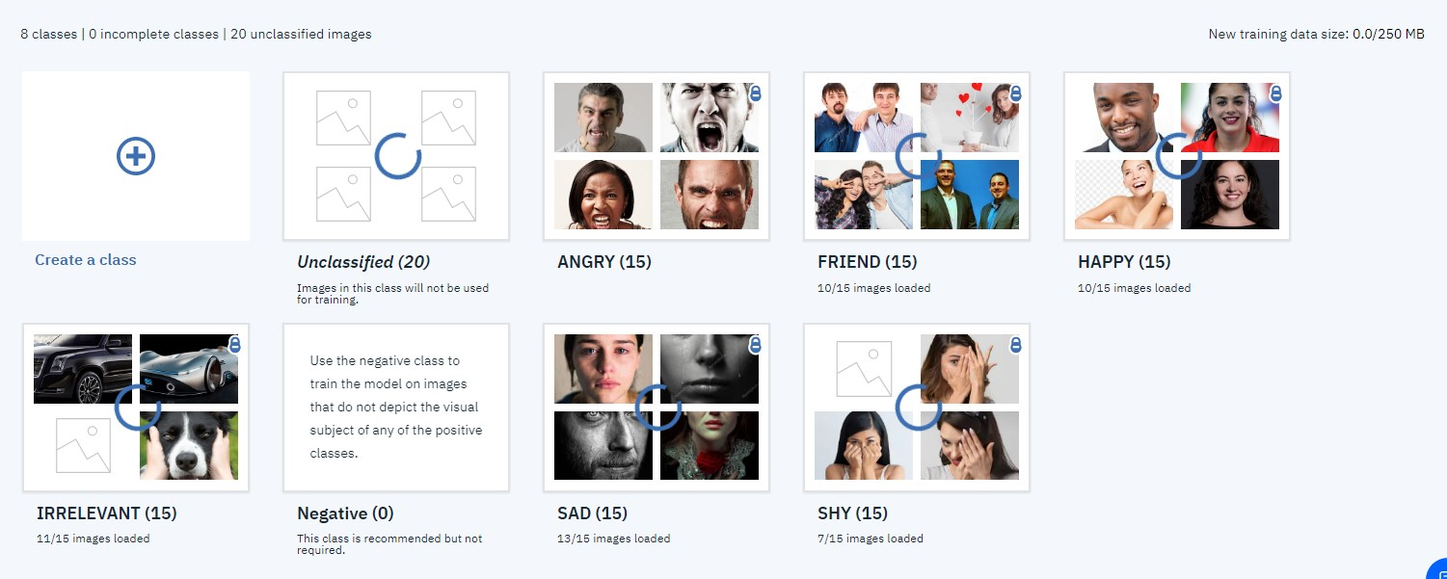
Project Steps
Collecting pictures from the Internet (about 240 photos)
Creating an IBM Watson account.
Feeding IBM Watson with our data.

Slide 5
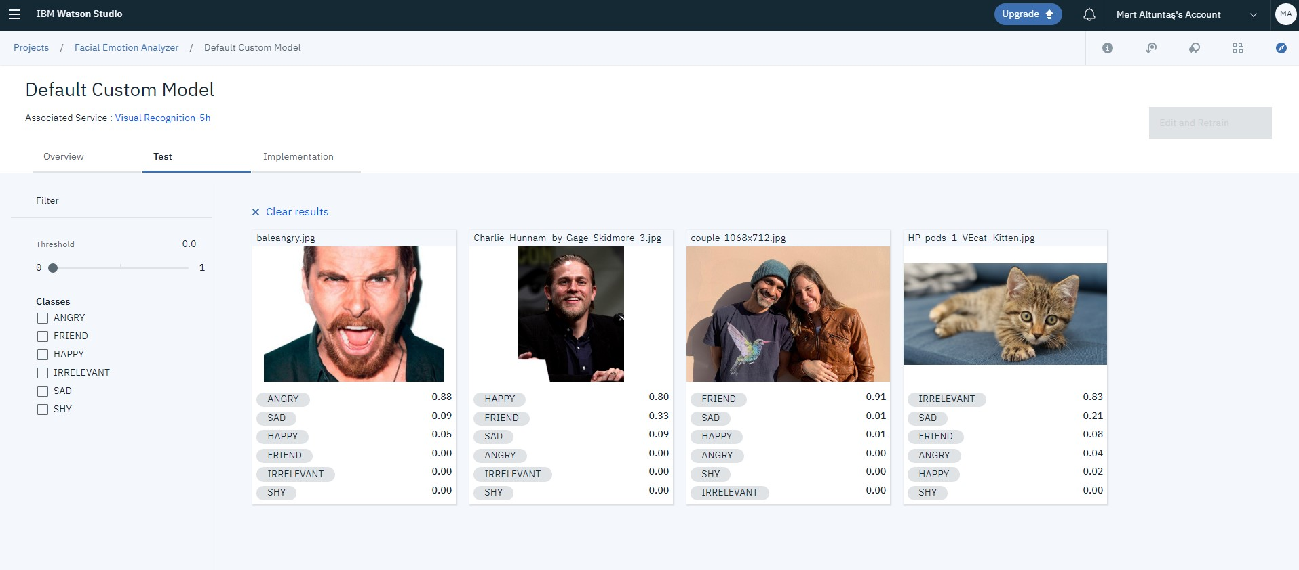
Making tests and calculations to find accuracy.
80 photo used for testing.
Accuracy result ; %91,25 correct , %8,75 mistaken.

Slide 6
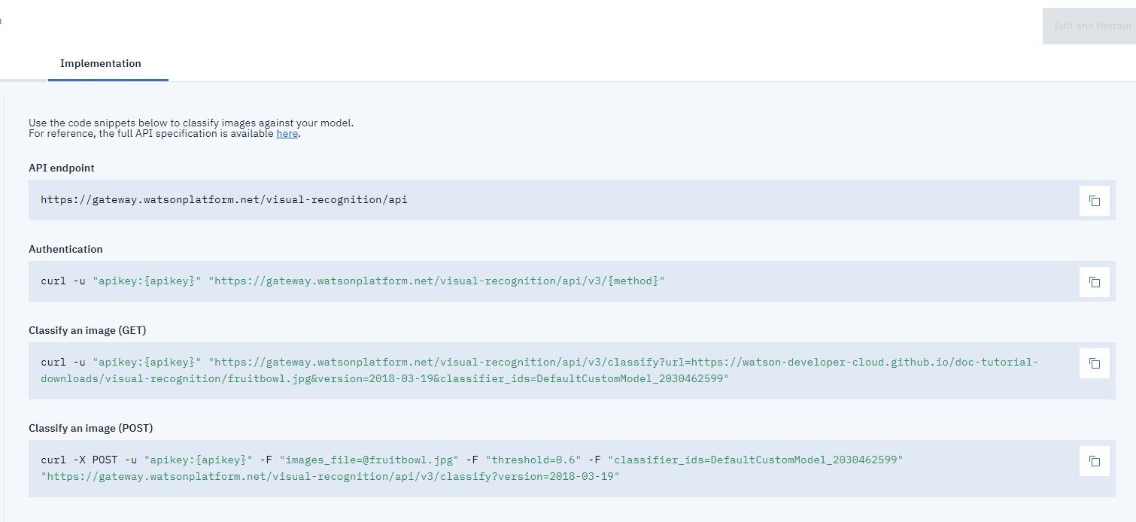
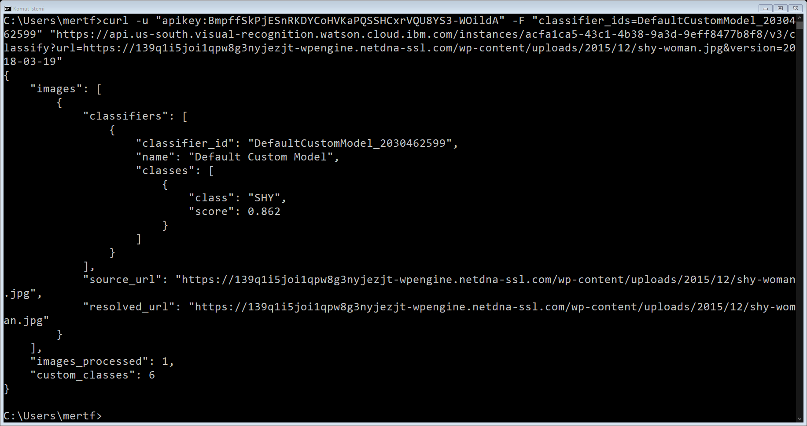
Learning curl commands and their usage.
Calling the system with curl commands in Windows.

Slide 7
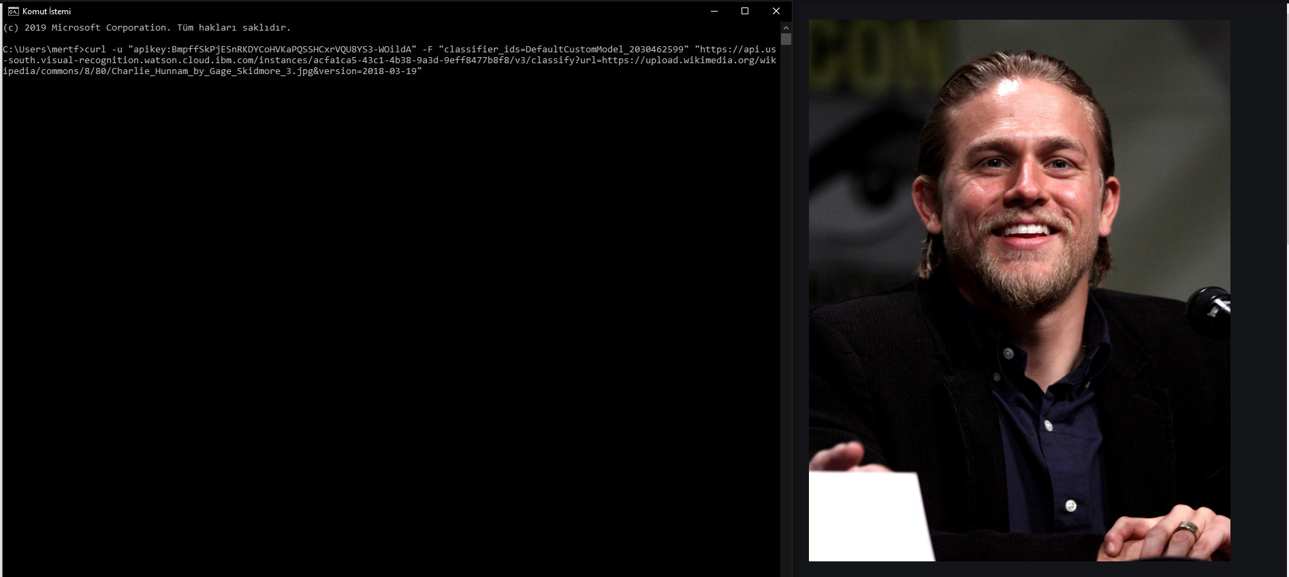
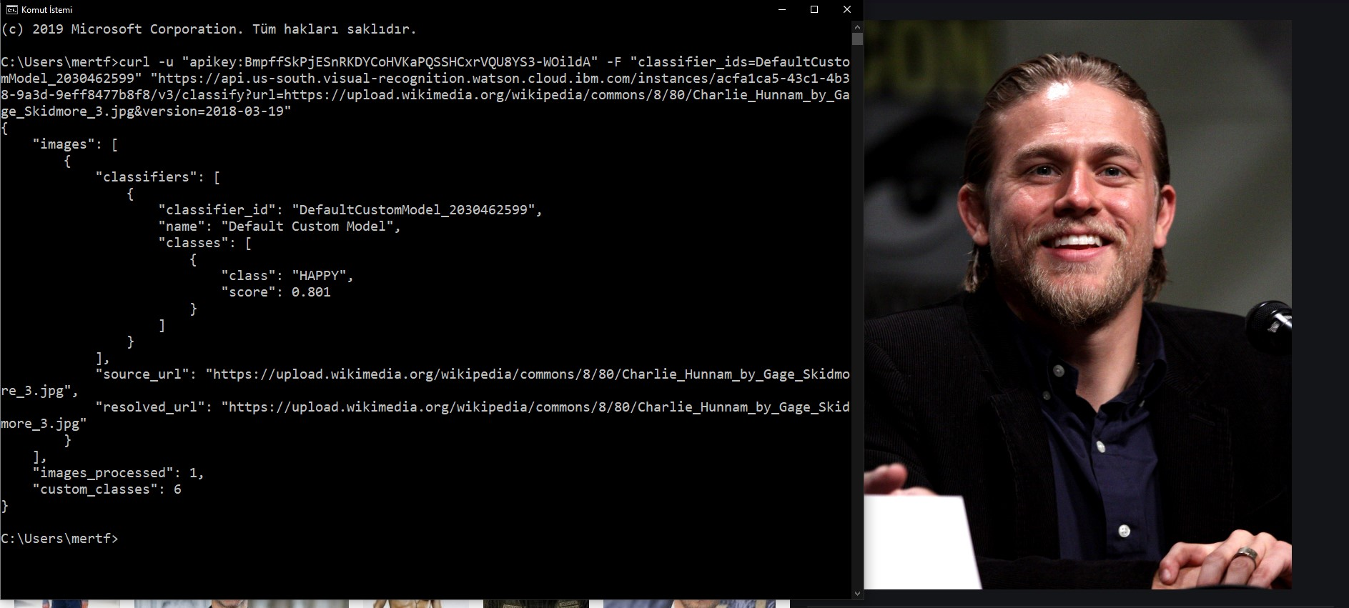
> Samples of Curl Command’s Usage
When we use the curl command ;

Slide 8
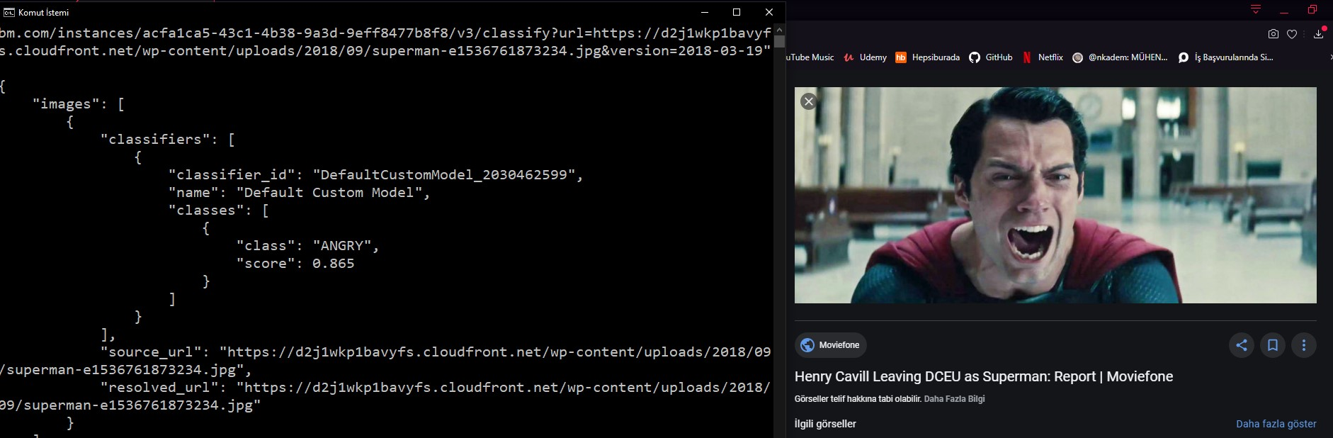


Slide 9
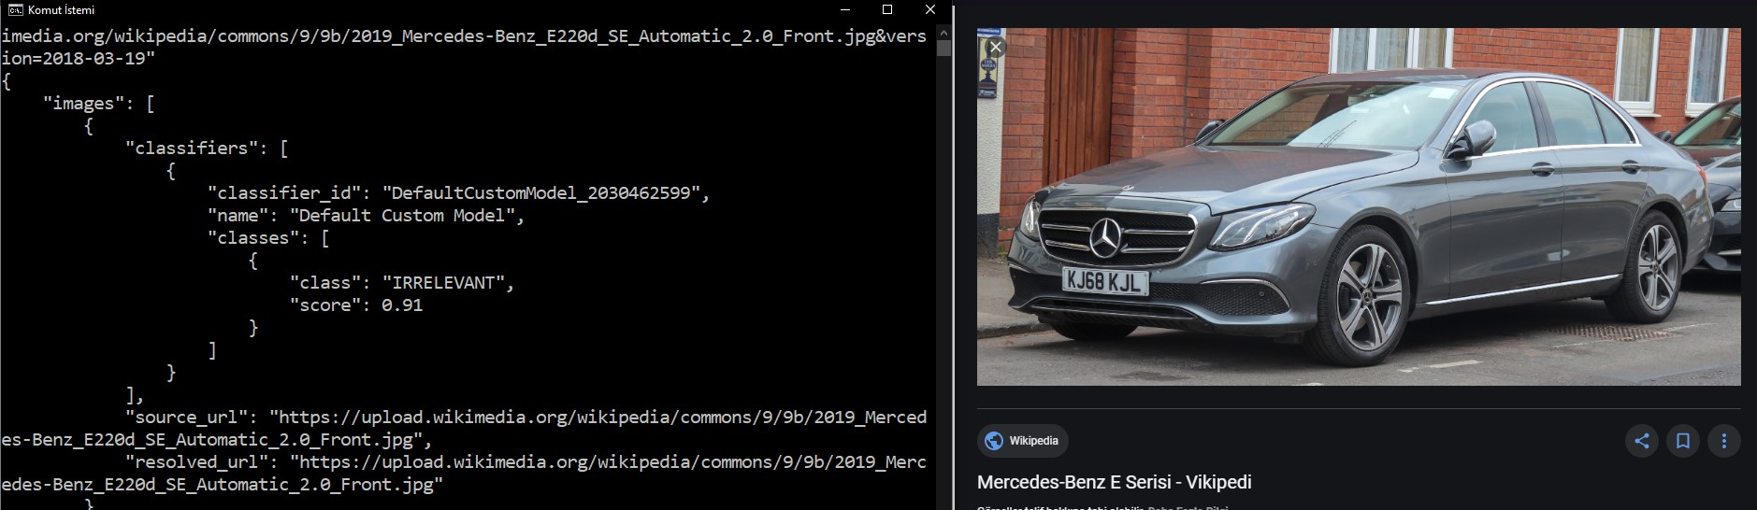
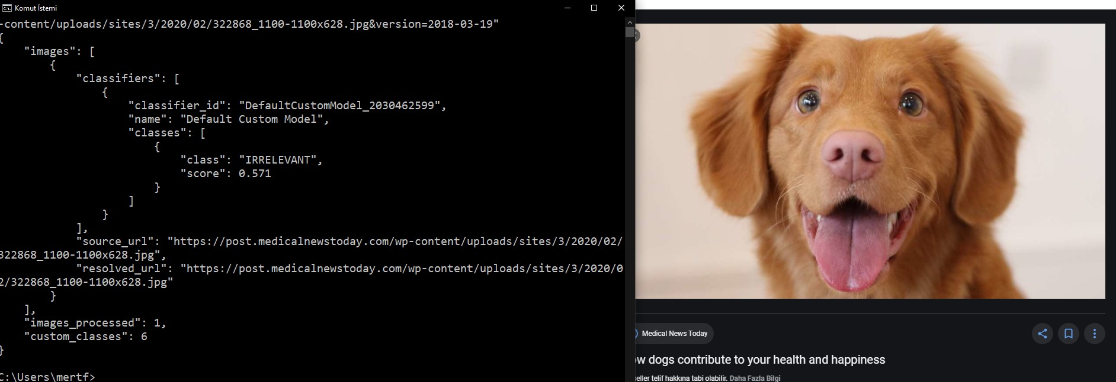

Slide 10
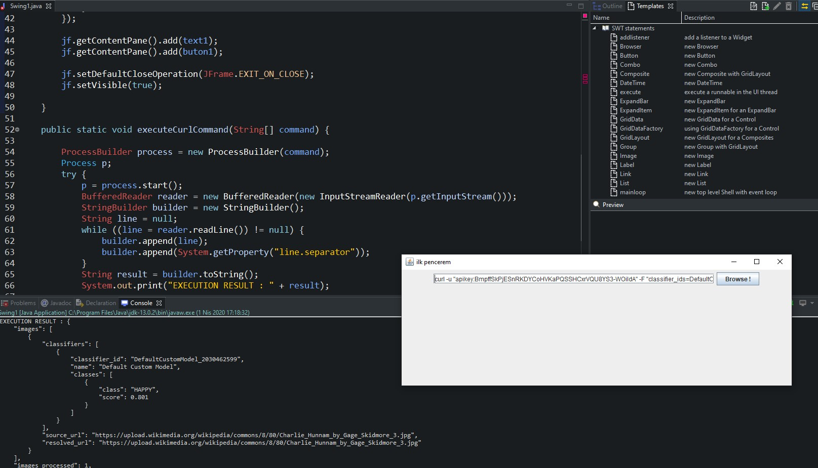
Developing User Interface in Java (Eclipse)

